Slide 1
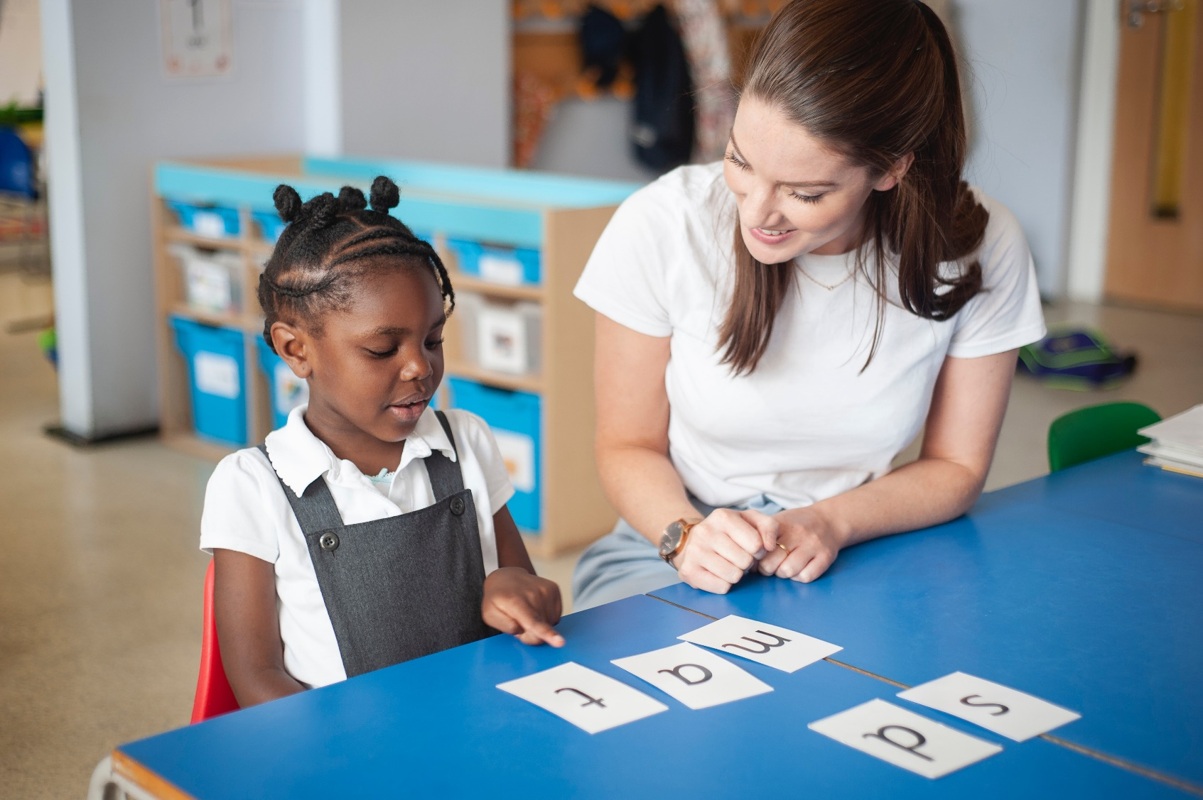
One-to-one tutoring – ‘keep up, not catch up!’
Notes:
We want to make sure every child learns to read in our school.
Some children need extra practice when learning to read so we teach these children one-to-one for ten minutes every day – on top of their group lesson.
We make sure they ‘keep up’ from the beginning and don’t need ‘catch up’ later on.

Slide 2
Speed Sounds Set 1 and Set 2
Notes:
Using RWI, we make learning to read easy for children because we start by teaching them just one way of reading and writing every sound. Here they are on the Simple Speed Sounds chart we use in class.
We teach Set 1 sounds first - (sounds as far as a e i o u).
Children need to know sounds – not letter names – to read words.

Slide 3
Speed Sounds Set 3
Notes:
Once children know one way of reading and writing every sound, they start to learn spellings for each sound they already know.
Point to the chart to show.
For example, they know ‘ay’ and now learn a-e and ai as other spellings for the same sound.

