Slide 2


Sounds + blending = reading
+
Notes:
Alongside teaching children sounds, we teach them to blend sounds to read words e.g. s-a-t, sat.
We use Fred Talk to help children read.

Slide 3
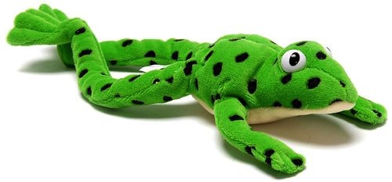
Fred
Notes:
Let me introduce you to Fred.
Fred can only speak in sounds. He says d-o-g, h-a-t etc.
Speaking like Fred helps children to understand that words are made up of sounds.
Fred helps children practise blending sounds together because he needs the children to say the words for him. Fred says d-o-g, children tell him the word is dog.
This is how we quickly teach all of our children to blend.

Slide 4

Teach spelling using Fred Fingers
Notes:
We use Fred Fingers to help children sound out words to spell easily.
It means they do not have to memorise lists of spelling words.
It is a tool so they will be able to spell any word.

Slide 5
‘Three with me, four at home’
Accuracy
Fluency
Comprehension
Read and enjoy at home
Notes:
In our school, children read each Read Write Inc. Storybook three times in class with their partner.
Re-reading the same book helps children to become confident readers. Each time they re-read, they build their fluency/speed and comprehension.
They love reading and want to read because they can read all of the words in the Storybook.
We set a focus for each re-read in school.
(Click) The first read focuses on reading every word accurately.
(Click) The second on reading the story more quickly.
(Click) The third read on comprehension - understanding what they read.
Then your child brings the same book home to read and enjoy with you again and again at home.
It’s ‘three with me, four at home.’
We do not send stories home the children cannot read because we always want them to be set up to succeed in their reading.
We want to make sure they enjoy reading so that they want to read.
The more they read, the faster progress they will make.

Slide 6

After the third read…
Notes:
So after the third read in class, children will able to access this book on Oxford Owl.
They love this book!
They can read it like a storyteller and can’t wait to read it to you, their grandparents or even their teddy bear.
Please avoid saying, “This book is too easy for you!” but instead say “I love how well you can read this book!”
They are meant to be able to read all of the words as the book is at the correct level.
Encourage them to share their enjoyment of the story with you and read it in their storyteller voice – again and again.

Slide 7


‘Special Friends’, ‘Fred Talk’, read the word
Notes:
Children will be able to read all of the words in the Storybook.
If they hesitate, remind them to read the word using ‘Special Friends, Fred Talk, read the word’.
For example, this means they spot the ‘sh’, then Fred Talk and blend to read the word e.g. sh, sh-i-p, ship.

Slide 8


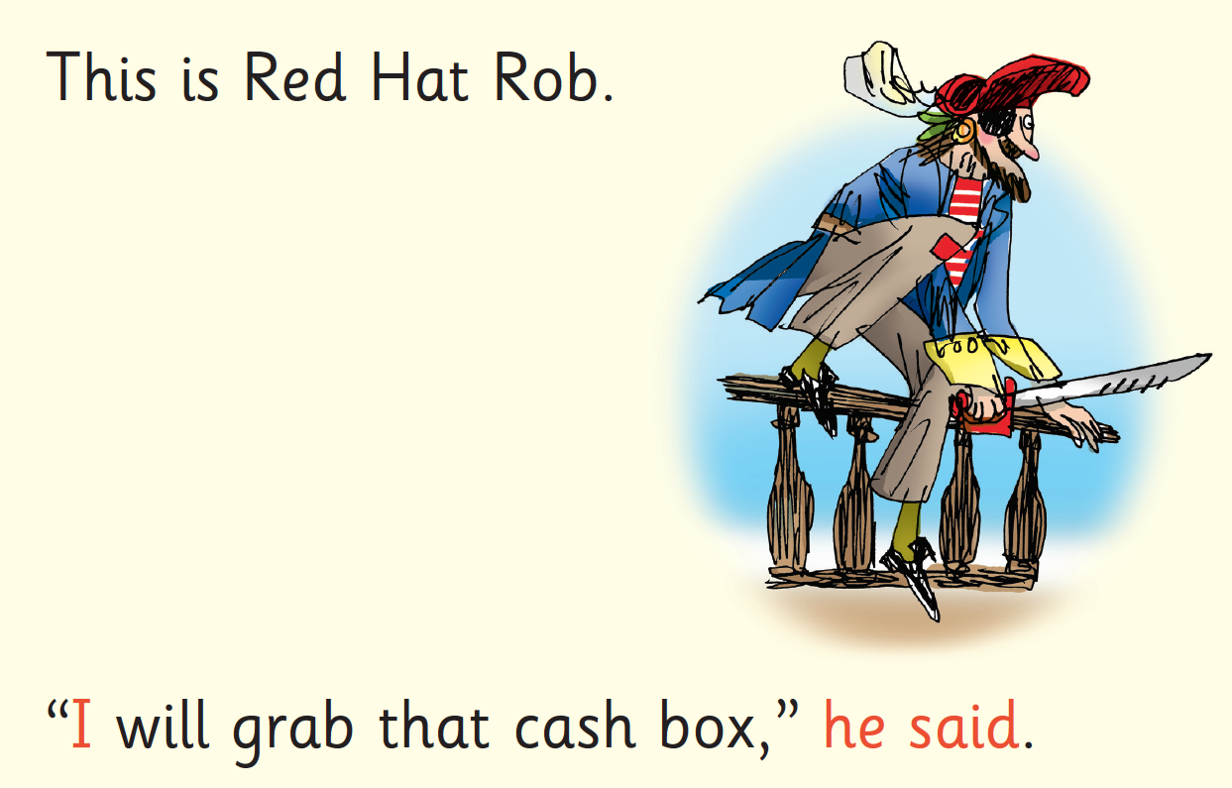
Red Words
Notes:
Some words are ‘tricky’ because they contain letters that don’t match the sounds the child has been taught.
For example, ‘said’ has ‘ai’ making an ‘e’ sound.
We teach these common exception words as Red words.
In the early Storybooks, these words are printed in red text.
Remind your child not to use Fred Talk to read Red words but instead to stop and think. Tell them the word if needed.

Slide 9
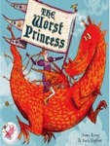



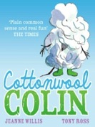
Which books will children bring home?
+
+
+
Notes:
Your child can read their storybook on Oxford Owl. These will be issued every three days, after they have read the book several times at school.
Your child will come home with a ‘book bag book’ every three days. These books will work specifically on the sounds the children have been working on at school that week.
Every Friday your child will choose a book to read for pleasure from our class library. This will be a picture book that should be read to your child.

Slide 10
What can I do?
Use pure sounds, not letter names
Use Fred Talk to read and spell words
Listen to your child read their Storybook every day
Read stories to your child every day

