Slide 1

Online Safety
At spurcroft primary school
Mrs Chrissie munday
Computing subject Leader

Slide 2
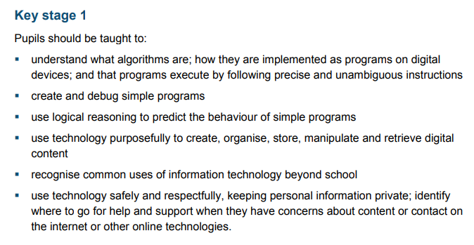
National Curriculum

Slide 3
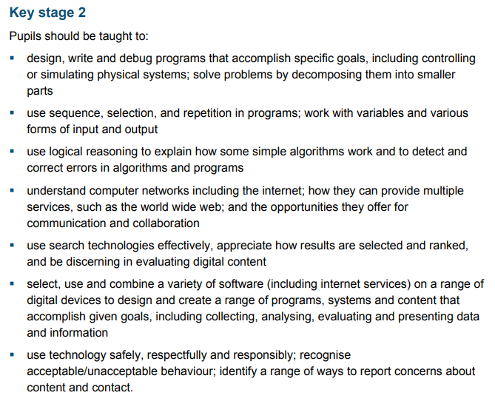
National Curriculum

Slide 4

Vision for Computing at Spurcroft
At Spurcroft Primary School, we aspire for the children to be confident users of technology where they have the opportunities to collaborate and problem solve through computational thinking. We are committed to providing a range of engaging experiences that encourage pupils to think creatively whilst using technology as a purposeful tool. By challenging pupils to consider both the advantages and disadvantages to working online, we aim to prepare them for entering the 21st Century workforce by ensuring that they can connect with the wider world in a safe and responsible manner.

Slide 5

New Government advice for teaching online safety
Available at:
https://www.gov.uk/government/publications/teaching-online-safety-in-schools

Slide 6

Building on this framework published in 2018.
Available at:
https://assets.publishing.service.gov.uk/government/uploads/system/uploads/attachment_data/file/759003/Education_for_a_connected_world_PDF.PDF

Slide 7
Key focus points and aims of the new guidance
AIMs
Focus points
Children should be taught about:
How to evaluate what they see online
How to recognise techniques used for persuasion
Online behaviour
How to identify online risks
How and when to seek support
How to navigate the internet and manage information
How to stay safe online
Wellbeing

Slide 8
How to navigate the internet and manage information
Potential Harm/Risk | EYFS | KS1 | LKS2 | UKS2
Age restrictions | ✓ | ✓ | ✓ | ✓
How content can be used and shared |  |  | ✓ | ✓
Disinformation, misinformation and hoaxes |  |  | ✓ | ✓
Fake websites and scam emails |  |  |  | ✓
Online fraud |  |  |  | ✓
Password phishing |  |  |  | ✓
Personal data |  | ✓ | ✓ | ✓
Persuasive design |  |  |  | ✓
Privacy Settings |  |  | ✓ | ✓
Targeting online content |  |  |  | ✓

Slide 9
How to stay safe online
Potential Harm/Risk | EYFS | KS1 | LKS2 | UKS2
Online abuse |  |  | ✓ | ✓
Online challenges |  |  |  | ✓
Content which incites |  |  |  | ✓
Fake profiles |  | ✓ | ✓ | ✓
Grooming |  |  | ✓ | ✓
Live streaming |  |  |  | ✓
Pornography | Only taught at Secondary
Unsafe communication | ✓ | ✓ | ✓ | ✓

Slide 10
Wellbeing
Potential Harm/Risk | EYFS | KS1 | LKS2 | UKS2
Impact on confidence (including body confidence) |  |  |  | ✓
Impact on quality of life, physical and mental health and relationships. |  | ✓ | ✓ | ✓
Online vs. offline behaviours | ✓ | ✓ | ✓ | ✓
Reputational damage | Only taught at Secondary
Suicide, self-harm and eating disorders

Slide 11
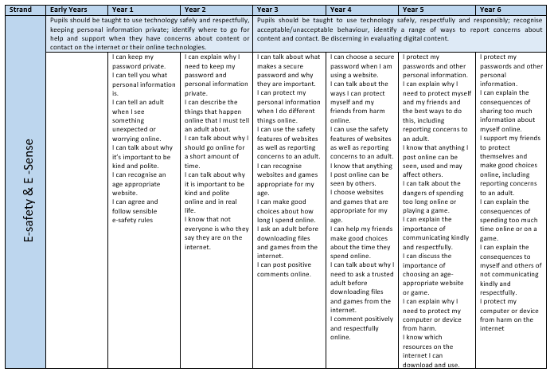
How we teach this…

Slide 12
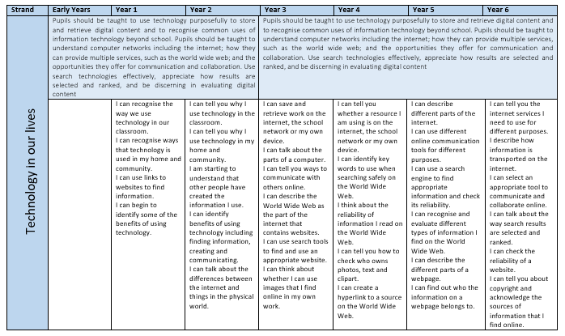

Slide 13

How can you help your child at home?
Promote safe and healthy online behaviour whenever using devices – highlight features that keep us safe.
Make a family agreement for how to use technology safely.
Make sure children know what to do if they see something that upsets them – especially if someone asks them to keep it secret.
Where possible, ensure technology use is in family areas rather than in bedrooms
Read age appropriate books to introduce online safety ideas.
Use online resources and games to teach about online safety.
Address some risks as need arises so not to scare children.

Slide 14







Useful resources
Online resources:
https://www.internetmatters.org/
https://www.thinkuknow.co.uk/
https://www.nspcc.org.uk/preventing-abuse/keeping-children-safe/online-safety/
https://www.saferinternet.org.uk/advice-centre/parents-and-carers
https://www.childnet.com/parents-and-carers
https://parentzone.org.uk/
https://www.commonsensemedia.org/

Slide 15










Useful resources
Books:

Slide 16

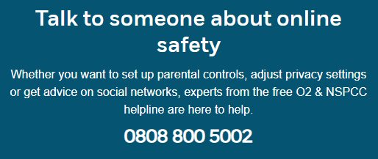
Useful Resources
Specific Advice:
https://www.askaboutgames.com/
https://nationalonlinesafety.com/

Slide 17

Information on age
https://www.istockphoto.com/gb/photos/number-13?sort=mostpopular&mediatype=photography&phrase=number%2013

Slide 18
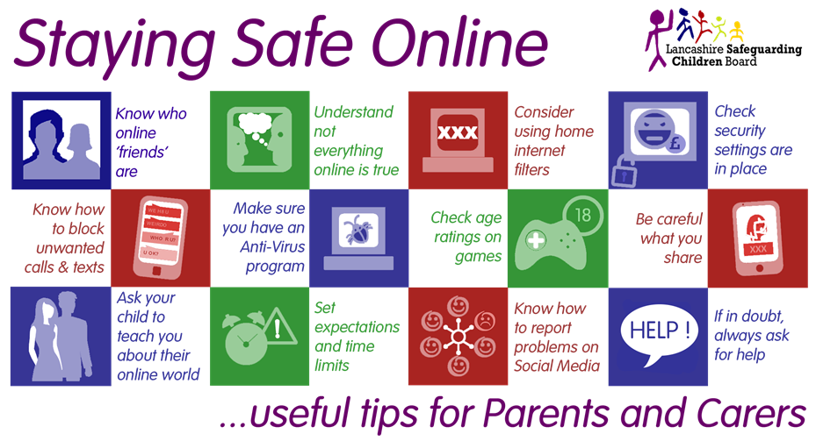

Slide 19
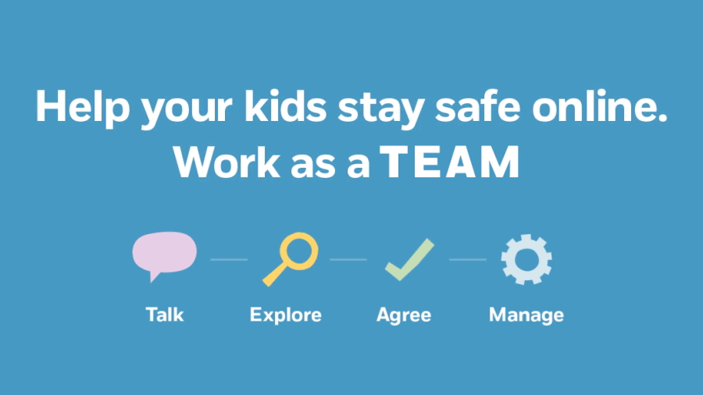
https://www.nspcc.org.uk/preventing-abuse/keeping-children-safe/online-safety/

