Slide 1
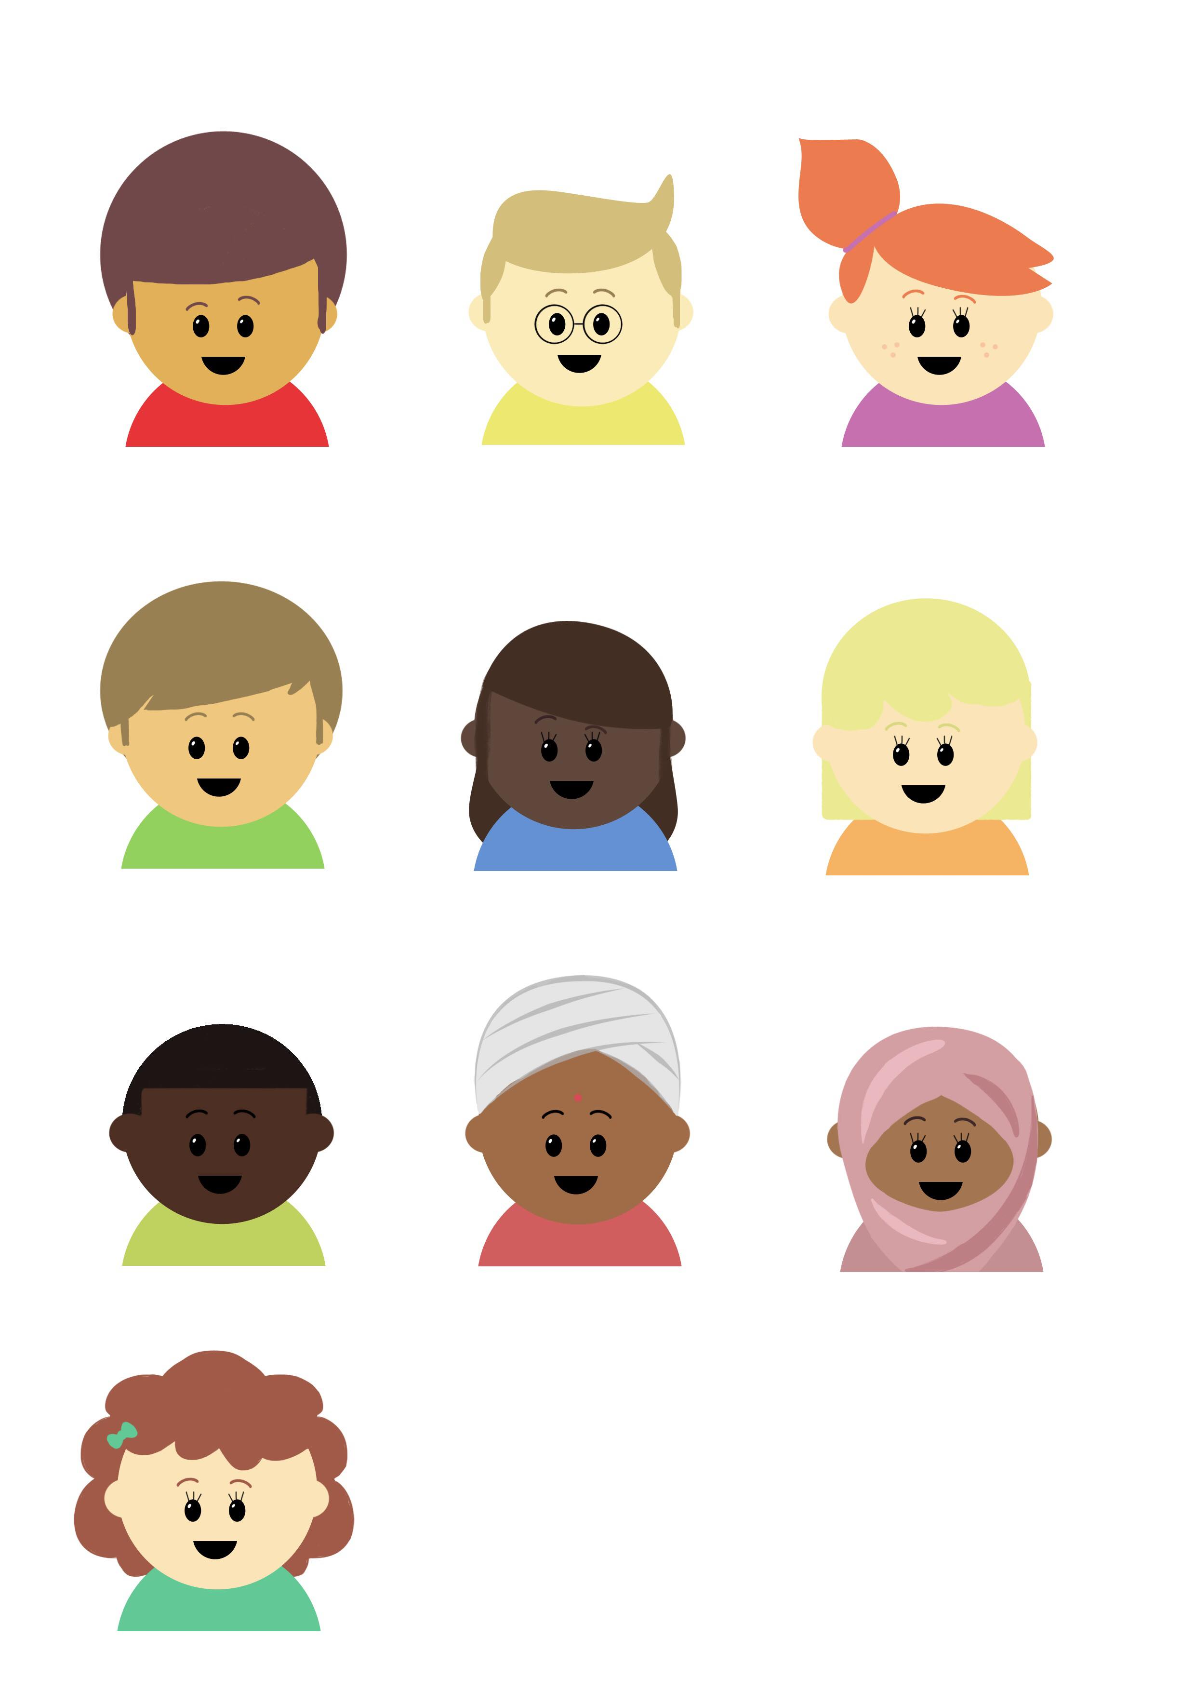

Progression in Mastery
Year 6 Add and Subtract Fractions 2
Let’s dive deeper into calculating fractions!
©Deepening Understanding LTD 2019

Slide 2

Let’s do this!
How much cake is left?
I have eaten
I have eaten
3
8
3
16
©Deepening Understanding LTD 2019

Slide 3
Let’s revisit what we should know.
When we add and subtract fractions, we use the ________ ________ ________ of the fractions’ ________.
Twelve is the lowest common multiple of 12 and 3.
3
12
2
3
11
12
+
=
2
3
1
12
7
12
-
=
We all say it!
You say it!
I say it!
©Deepening Understanding LTD 2019

Slide 4
Let’s learn
Sometimes, the denominators are not multiples of the same number.
In this case, we have to find a common multiple.
We can multiply the two denominators together to find this.
3 × 7 = 21
1
3
3
7
?
?
+
=
©Deepening Understanding LTD 2019

Slide 5
Let’s learn
3 × 7 = 21
1
3
3
7
?
?
+
=
×7
×3
7
21
9
21
16
21
+
=
Remember to multiply the numerator AND the denominator by the same number.
©Deepening Understanding LTD 2019

Slide 6
Let’s learn
Let’s look at this visually….
1
3
×7
7
21
=
×7
3
7
×3
9
21
=
×3
16
21
=
©Deepening Understanding LTD 2019

Slide 7
Let’s talk
How will you add these fractions?
Draw bar models to prove your answers.
2
5
2
9
?
?
+
=
1
3
5
13
?
?
+
=
©Deepening Understanding LTD 2019

Slide 8
Let’s develop our learning
We need to convert these fractions in the same way before subtracting.
3
4
5
9
?
?
+
=
×9
×4
27
36
20
36
7
36
+
=
©Deepening Understanding LTD 2019

Slide 9
Let’s learn
Let’s look at this visually….
3
4
×9
27
36
=
×9
5
9
×4
20
36
=
×4
7
36
=
©Deepening Understanding LTD 2019

Slide 10
Let’s talk
Convert then subtract these fractions.
Draw bar models to prove your answers.
5
7
2
5
?
?
-
=
7
9
4
7
?
?
-
=
©Deepening Understanding LTD 2019

Slide 11
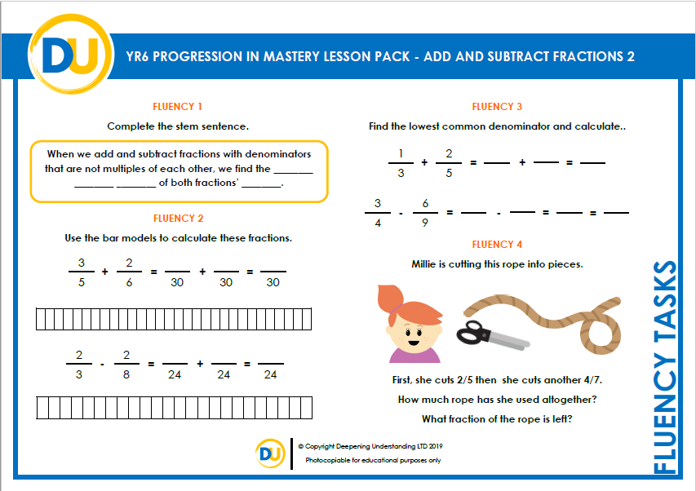
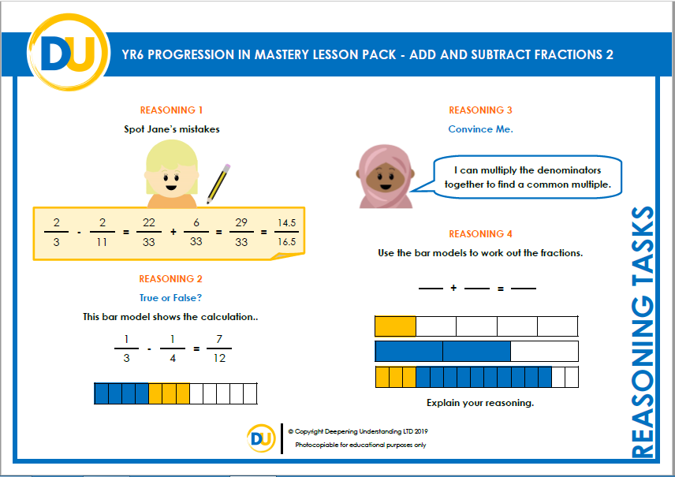
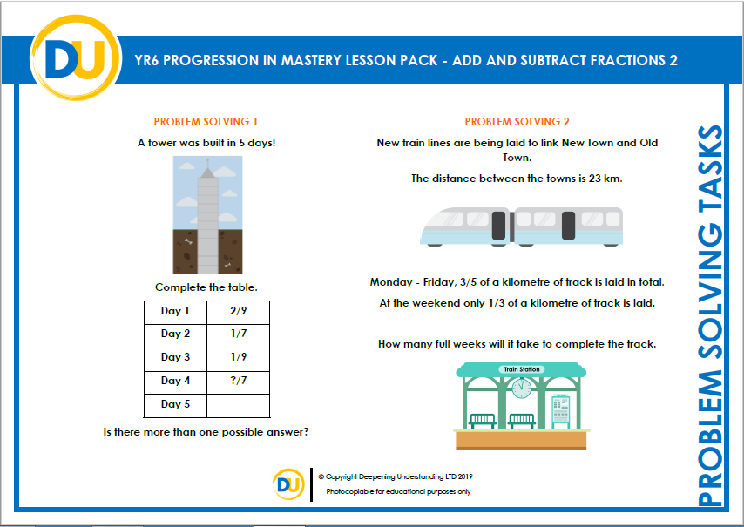
Independent Task
Let’s showcase our learning
©Deepening Understanding LTD 2019

Slide 12

Exit task – Dong Nao Jin
Jane’s mum received two boxes of chocolates for Valentine’s day.
Jane sneakily ate some without her mum knowing!
What fraction of the chocolates are left?
2
11
She ate from the first box.
She ate from the second box.
3
7
©Deepening Understanding LTD 2019

