Slide 1
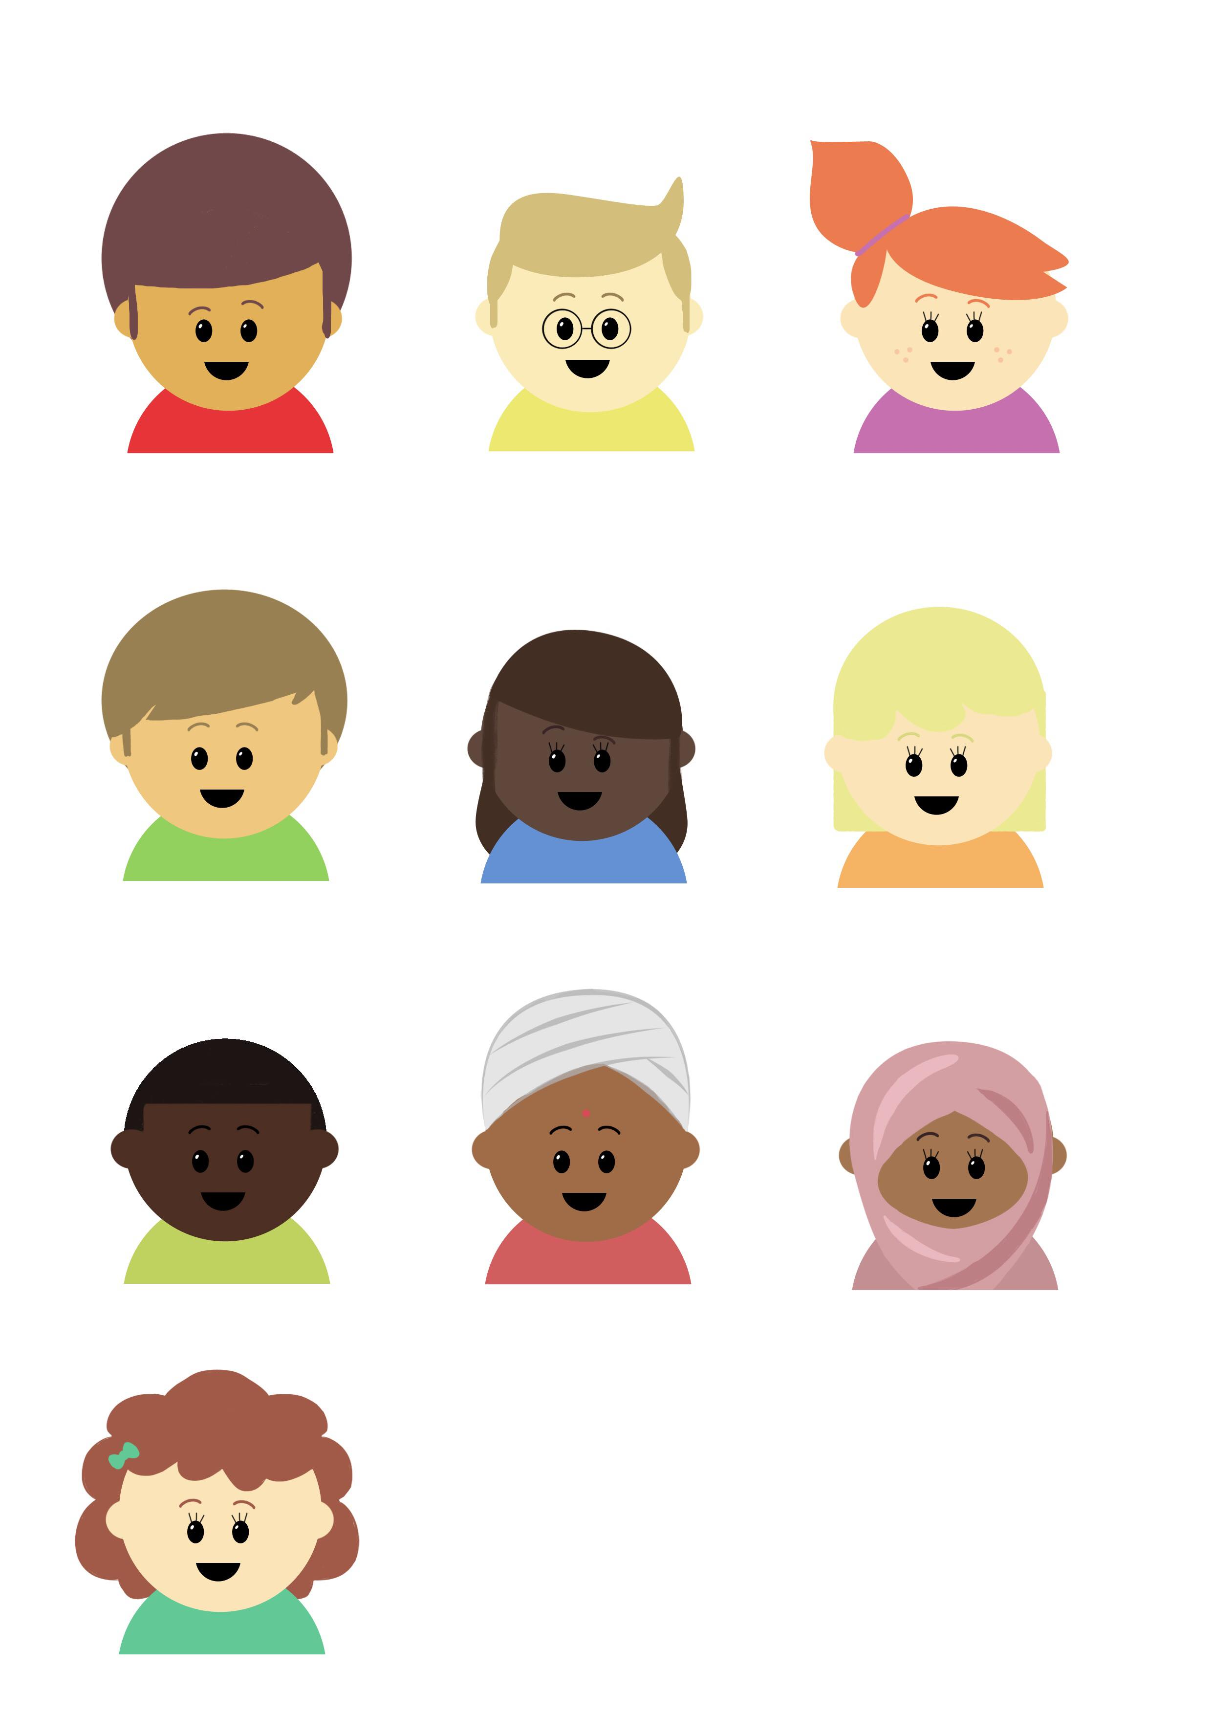

Progression in Mastery
Year 6 Adverbs for Degrees of Possibility
Are you ready to use amazing adverbs?
©Deepening Understanding LTD 2020

Slide 2
Let’s do this!
True or False?
Each of Ranjit’s sentences uses modal verbs to indicate certainty.
Prove it!
Before starting your dinner, you must wash your hands.
If you eat healthily and exercise regularly, you will feel better.
We could go to Barbados if we save more money this year.
©Deepening Understanding LTD 2020

Slide 3
Let’s revisit what we should know…
We can use adverbs to show degrees of possibility.
Some can be used to show certainty, for example…
Can you share any others which show certainty?
definitely
certainly
obviously
©Deepening Understanding LTD 2020

Slide 4
Let’s revisit what we should know…
We can use adverbs to show degrees of possibility.
Some can be used to show uncertainty, for example…
Can you share any others which show uncertainty?
possibly
perhaps
maybe
©Deepening Understanding LTD 2020

Slide 5
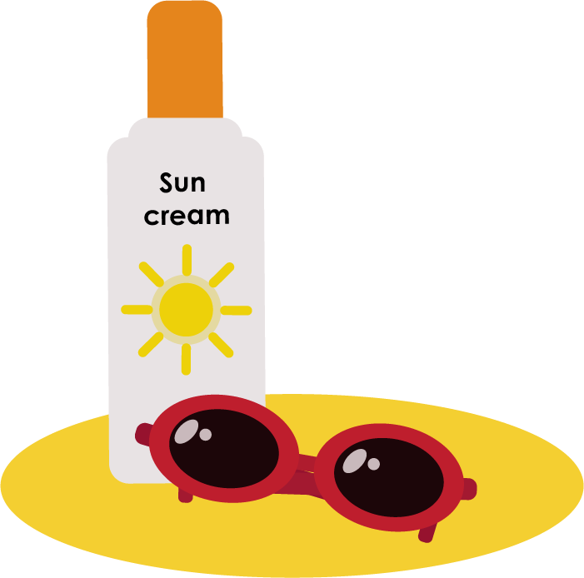
Let’s talk
Identify the adverbs for degrees of possibility in each sentence.
If the weather improves, we will probably head to the seaside this weekend.
Mr Lorenzo is undoubtedly the best Spanish teacher we’ve ever had.
It is unlikely that he will quit the team when he has tried so hard this year.
©Deepening Understanding LTD 2020

Slide 6

Let’s talk
Change the adverb in each sentence to change the degree of possibility or probability that the action will happen.
Surely Jane will win first prize in the athletics competition next season.
She obviously knows Marlon and Caleb from the drama club in town.
We could possibly invite some more people to the sleepover next time.
©Deepening Understanding LTD 2020

Slide 7
Let’s develop our learning
Ranjit used an adverb of certainty in his sentence.
Which sentence did he write? Convince me!
Perhaps we should take his temperature again to make sure it hasn’t got higher.
The famous artist has clearly written her signature on each of her paintings.
Maybe we could cycle to the sports centre together after school.
©Deepening Understanding LTD 2020

Slide 8
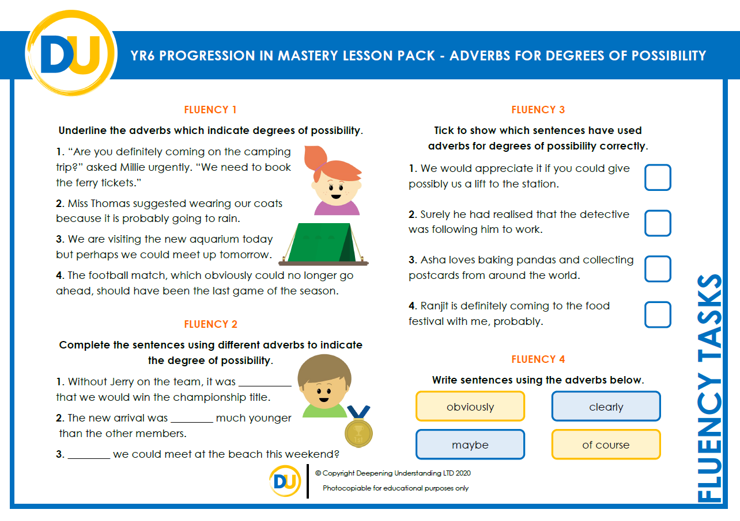
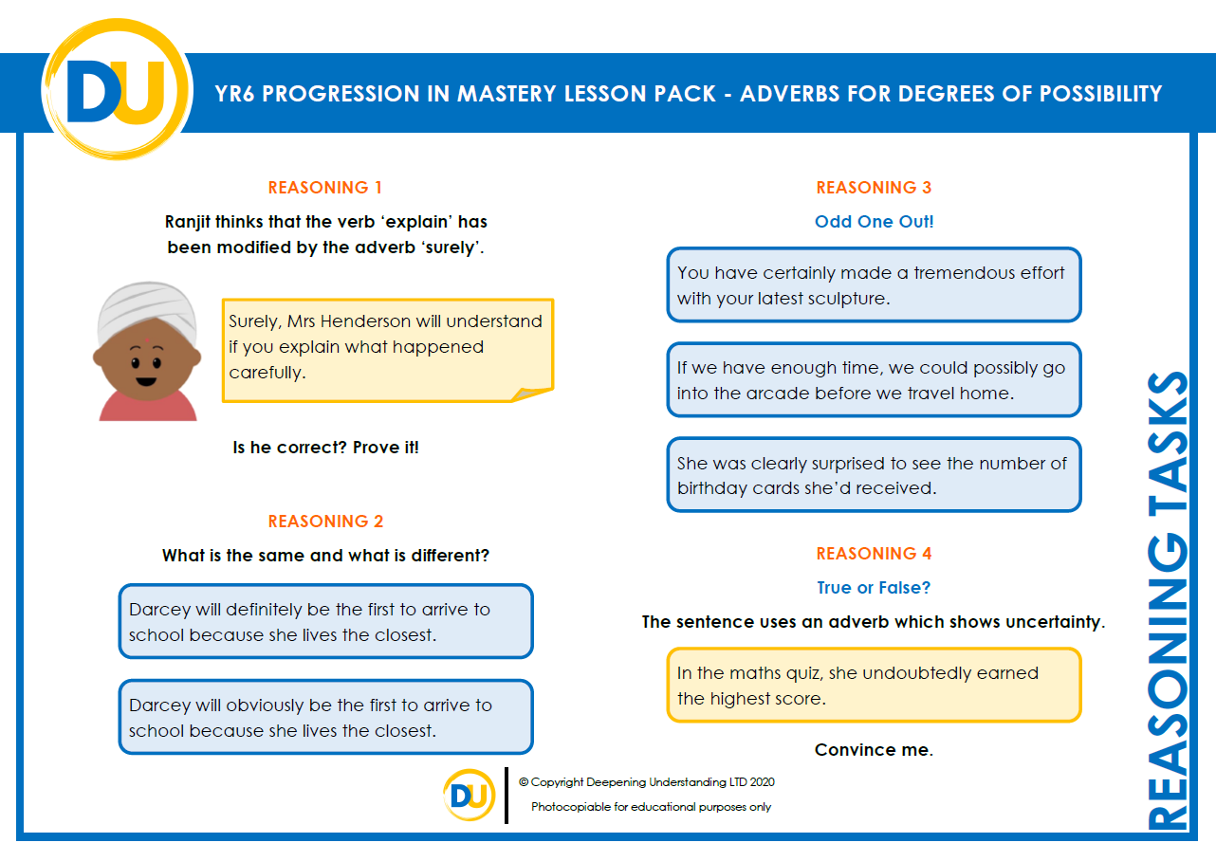
Independent Task
Let’s showcase our learning
©Deepening Understanding LTD 2020

Slide 9


Exit task – Dong Nao Jin
Order the sentences from the most to least
certain that the action will take place.
The announcement showed that the video game is unlikely to be released on time.
Those berries are undoubtedly the sweetest fruit I have ever tasted.
He will probably be busy over winter due to the closing down sale at his ski shop.
©Deepening Understanding LTD 2020

