Slide 1
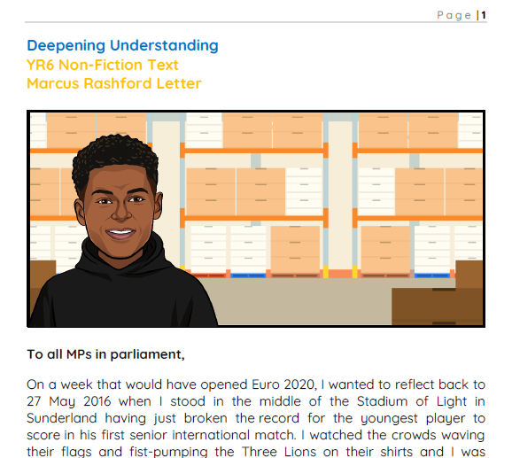

Whole Class Reading
Year 6 – Marcus Rashford’s Letter
For this session, you will need to have access to the DU text ‘Marcus Rashford’s Letter’.
©Deepening Understanding LTD 2022

Slide 2

Retrieval
Which is the correct answer?
Q1
How many meals per week does the campaign distribute?
A1
200,000
A2
1.3 million
A3
3 million
©Deepening Understanding LTD 2022

Slide 3
Retrieval
Which is the correct answer?
Q2
Who is sacrificing their own meals for the children?
A1
teachers
A2
headteachers
A3
parents
©Deepening Understanding LTD 2022

Slide 4
Retrieval
Which is the correct answer?
Q3
What limit per child per family does Universal Credit impose?
A1
2
A2
3
A3
5
©Deepening Understanding LTD 2022

Slide 5
Answers
Which is the correct answer?
Q1
3 million
Q2
parents
Q3
2
©Deepening Understanding LTD 2022

Slide 6
Vocabulary
What are the meanings of these words on page 4?
paragraph 3
paragraph 4
paragraph 5
Where?
Focus word
statistic
injustice
pleas
priority
©Deepening Understanding LTD 2022

Slide 7
Answers
What are the meanings of these words on page 4?
statistic
injustice
pleas
priority
a fact in numerical form that shows information about something
the condition of being unfair
urgent and emotional requests
something very important and must be dealt with before other things
©Deepening Understanding LTD 2022

Slide 8

Vocabulary
What does the word ‘overwhelmed’ suggest about the pride Rashford was feeling?
Think…
Where have you heard this word before?
‘I watched the crowds waving their flags and fist-pumping the Three Lions on their shirts and I was overwhelmed with pride not only for myself but for all of those who had helped me reach this moment…’
©Deepening Understanding LTD 2022

Slide 9
Acceptable Answers
Links to sudden feeling of emotion
The pride he felt came upon him suddenly.
Links to strong feeling of emotion
The pride he felt was so strong, it was almost too much.
Think…
Where have you heard this word before?
©Deepening Understanding LTD 2022

Slide 10
Model Answer
The feeling of pride Marcus experienced came on suddenly and it felt so strong, it was almost too much.
Think…
Let’s put it all together!
©Deepening Understanding LTD 2022

Slide 11

Inference
Are the following statements a fact or an opinion?
Marcus’ mum worked full-time.
Caleb
Marcus’ mum is selfless.
Marcus relied on breakfast club when he was younger.
Millie
Marlon
©Deepening Understanding LTD 2022

Slide 12
Answers
Are the following statements a fact or an opinion?
fact
Caleb
opinion
fact
Millie
Marlon
©Deepening Understanding LTD 2022

Slide 13
Inference
Look at paragraph 2.
Why has Rashford chosen to begin this paragraph using the word ‘understand’?
©Deepening Understanding LTD 2022

Slide 14
Acceptable Answers
He wants to ensure the reader knows exactly why he has been successful.
He wants the reader to know how much everybody’s kindness has helped him.
©Deepening Understanding LTD 2022

Slide 15

Inference with PEPE!
With extended answer questions, think about me (Pepe).
This will help us structure our response!
P
point
E
evidence
P
point
E
evidence
©Deepening Understanding LTD 2022

Slide 16
Inference with PEPE!
List two similarities in character between Rashford and his mum.
P
- similarity 1
E
- proof to support similarity 1
P
- similarity 2
E
- proof to support similarity 2
©Deepening Understanding LTD 2022

Slide 17
Model Answer
Let’s look at a model response…
Point 1 – They are both selfless.
Evidence – His mum sacrificed things when Marcus was young. Marcus wanted to help vulnerable families.
Point 2 – They are both determined.
Evidence – Rashford wrote the letter and his mum worked hard.
Marcus and his mum are both selfless - his mum sacrificed a lot for him when he was younger and Marcus is using his time to campaign for vulnerable families. They are both determined – Rashford is fighting for vulnerable families and his mum has worked hard all of her life to provide and she would be down at the job centre first thing if she lost her job.
©Deepening Understanding LTD 2022

Slide 18
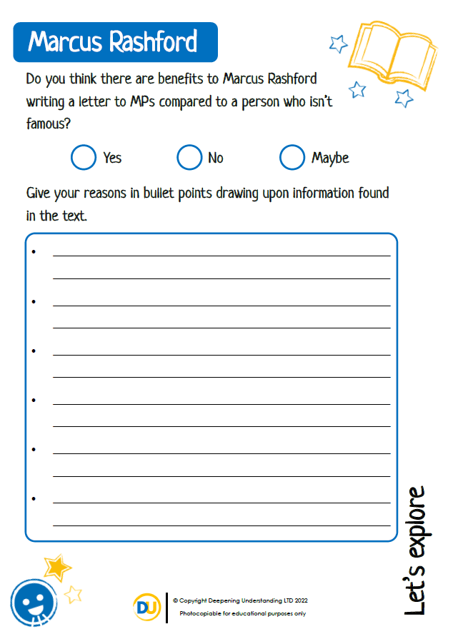

Explore
What are the benefits of Marcus Rashford writing a letter to MPs compared to a person who isn’t famous?
©Deepening Understanding LTD 2022

