Slide 1
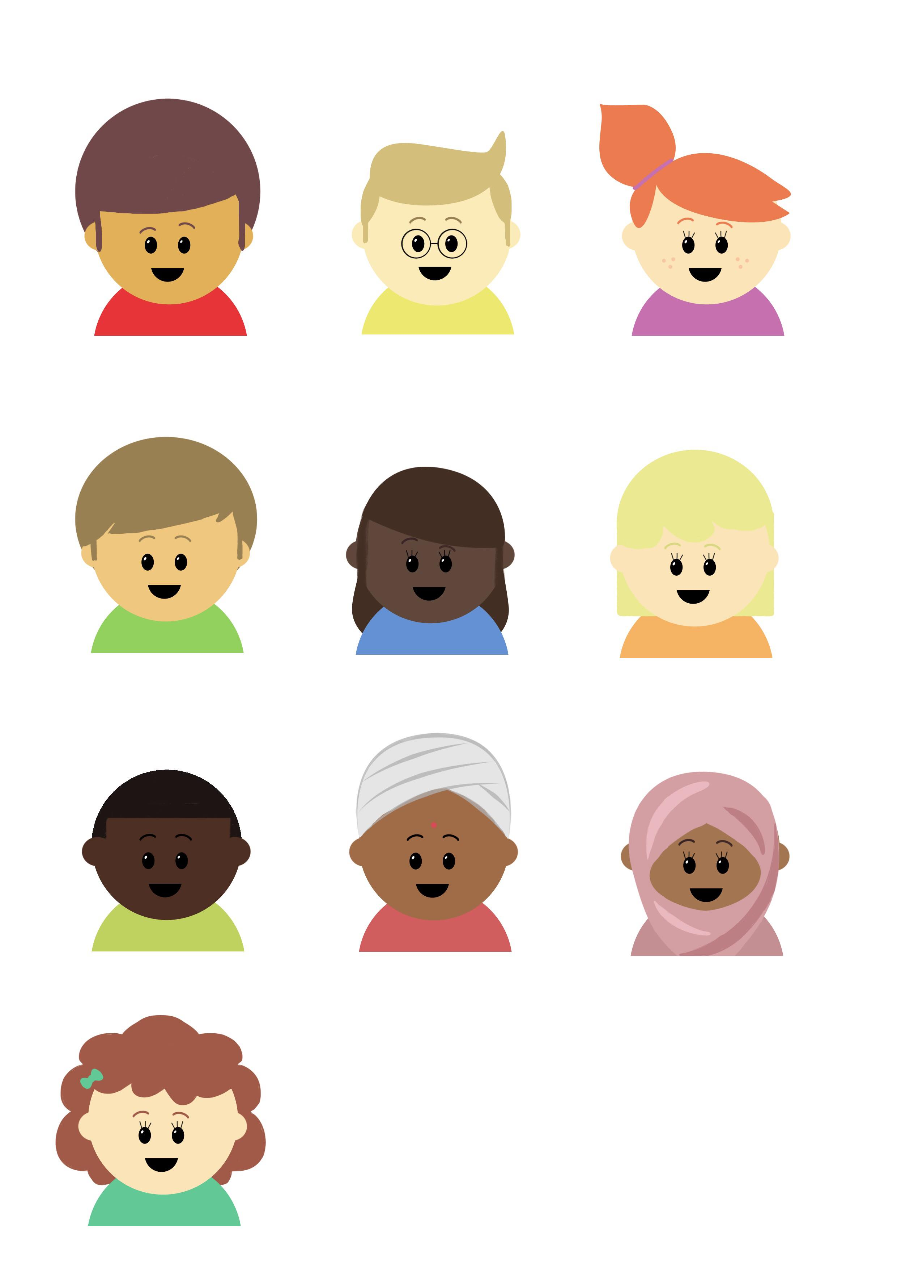

Progression in Mastery
Year 4 Direct Speech
Let’s dominate direct speech!
©Deepening Understanding LTD 2020

Slide 2
Let’s do this!
Discuss Ranjit’s one minute challenge with your partner.
Which pair has the most listed?
How many alternatives to ‘said’ do you know?
©Deepening Understanding LTD 2020

Slide 3
Let’s revisit what we should know…
Direct speech is a sentence where the exact words
that are spoken are written in inverted commas.
Mum asked, “Can you help me to peel the carrots and potatoes, please?”
“I’m going to order a large pizza with chicken and sweetcorn,” decided Caleb.
“I can’t wait to go to Canada!” exclaimed Millie. “We booked this trip over a year ago.”
©Deepening Understanding LTD 2020

Slide 4

Let’s revisit what we should know…
We use inverted commas before the first word and
after the last word that is spoken.
Punctuation, such as commas, full stops, question marks or exclamation marks come before the closing inverted comma.
“I completed my favourite video game
last night,” said Ranjit.
©Deepening Understanding LTD 2020

Slide 5
Let’s talk
What are the spoken words in each of these sentences?
“Please can I have raspberry sauce and sprinkles on my ice cream?” requested Darcey.
After painting the living room, the decorator explained, “We can fit your new carpet now.”
“I’ll take you to visit the castle tomorrow,” she revealed. “There will be a huge firework display in the evening.”
©Deepening Understanding LTD 2020

Slide 6


Let’s talk
How would we use inverted commas to punctuate this sentence?
Mum announced, We have made some fairy houses to decorate the garden. Which one do you like the most?
©Deepening Understanding LTD 2020

Slide 7

Let’s talk
How would we use inverted commas to punctuate this sentence?
There are so many weeds growing around the pond, cried Dad. Let’s work together to pull them all up quickly.
©Deepening Understanding LTD 2020

Slide 8
Let’s talk
Create a conversation between Ranjit and Jane.
Remember to use inverted commas!
Ranjit questioned, _________
___________________________
___________________________
___________________________________________________________________, replied Jane.
©Deepening Understanding LTD 2020

Slide 9
Let’s develop our learning
Odd One Out!
Is there more than one possibility? Convince me!
Marlon complained, “I think my tablet is broken. It takes ages to switch on and none of the apps are loading up.”
“We will have to try and get it repaired. It will be very expensive to replace,” explained Marlon’s mum.
Grandad declared, “I’m sure I can fix it. Hand it over to me.
©Deepening Understanding LTD 2020

Slide 10
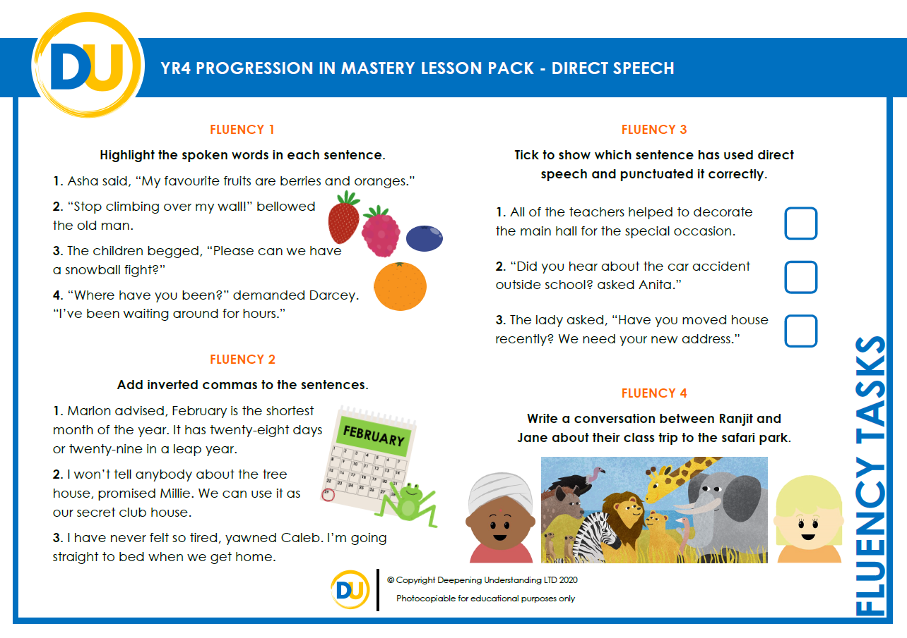
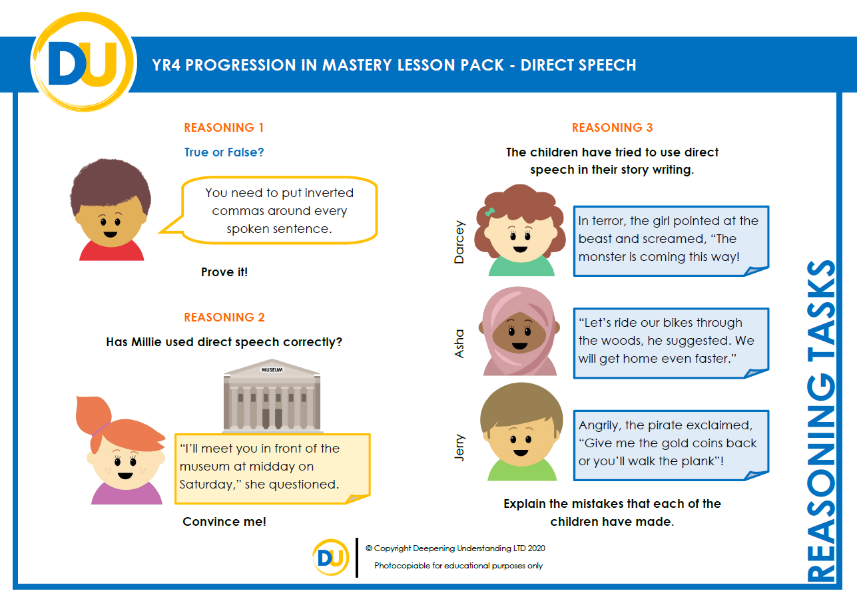
Independent Task
Let’s showcase our learning
©Deepening Understanding LTD 2020

Slide 11
Exit task – Dong Nao Jin
Choose a question to ask your partner.
NOW… Write your conversation down using
what you know about direct speech.
What is your favourite TV show and why?
If aliens exist, what do you think they look like?
If you could pick any superpower, what would it be?
©Deepening Understanding LTD 2020

