Slide 2








Next

Slide 3





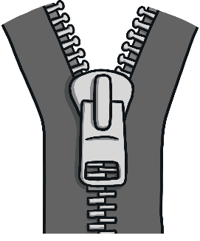
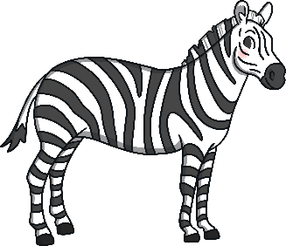


Zin

Slide 4
Zin
Next

Slide 5







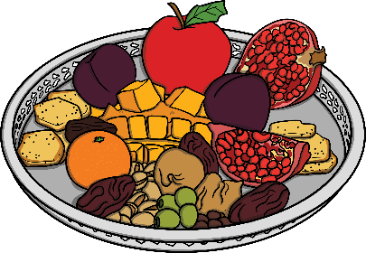
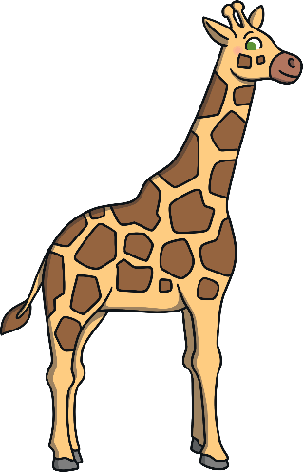

Fop

Slide 6
Fop
Next

Slide 7

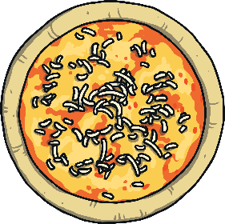
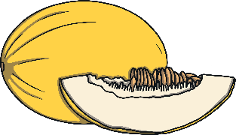




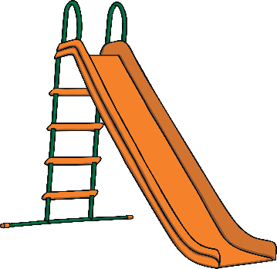


Mep

Slide 8

Mep
Next

Slide 9











Bik

Slide 10
Bik

