Slide 2
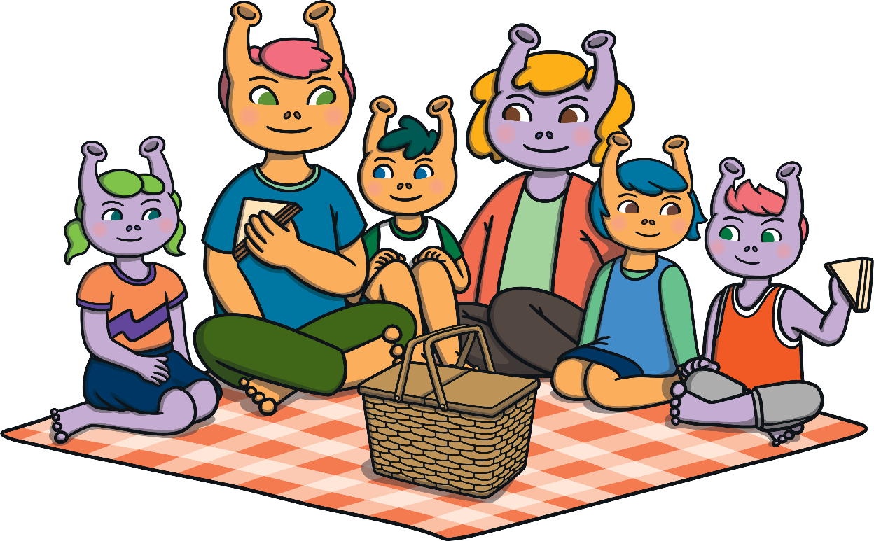

Click on the picnic basket to see what food the aliens have packed.

Slide 3

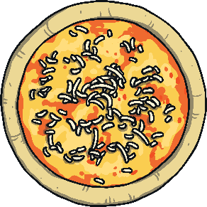




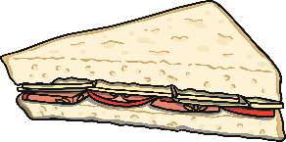


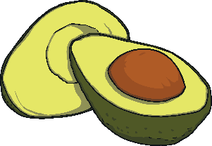






Next

Slide 4


Next

Slide 5

Next

Slide 6
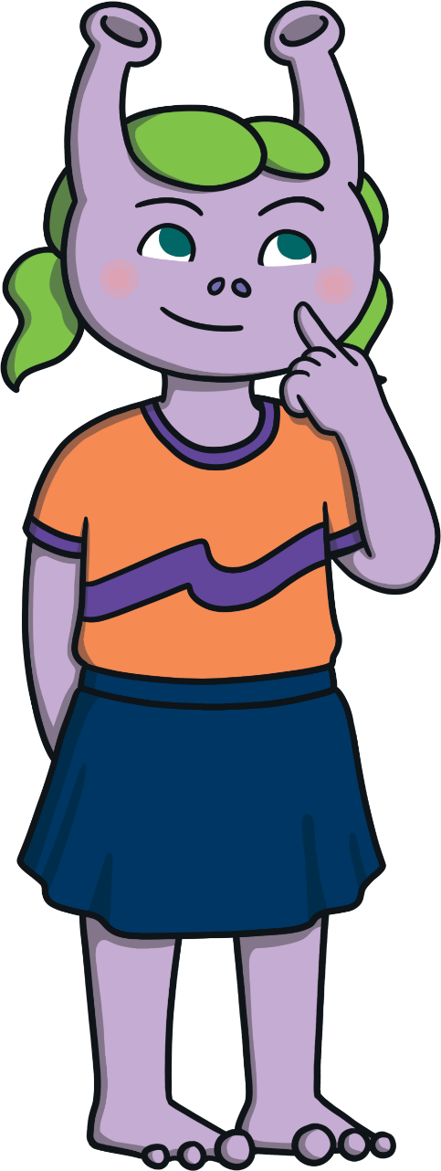

Next

Slide 7

Next

Slide 8
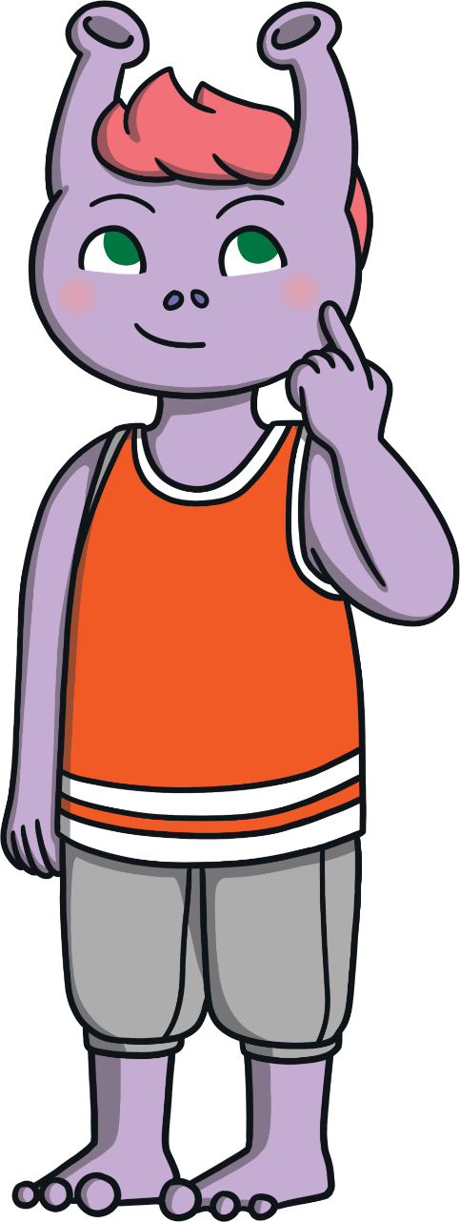

Next

Slide 9
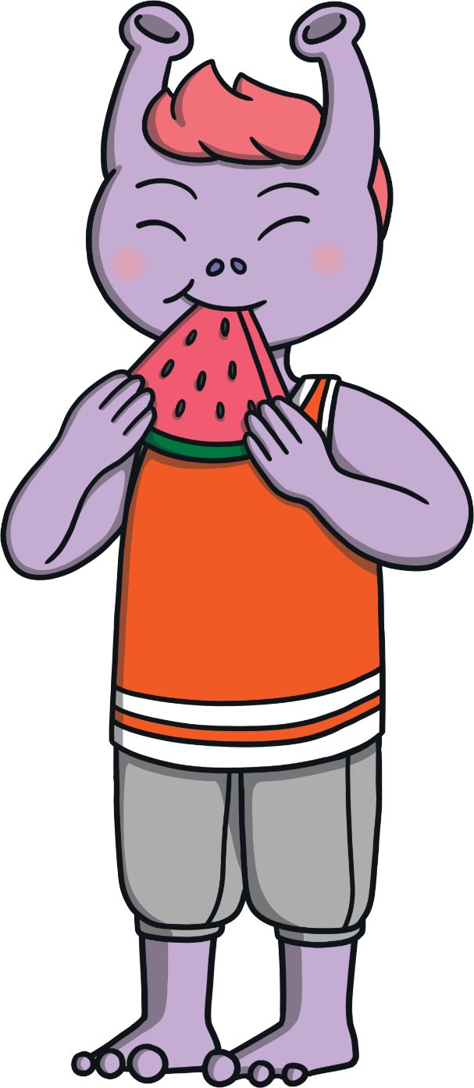
Next

Slide 10

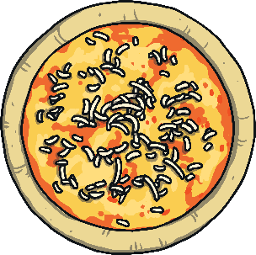
Next

Slide 11

Next

Slide 12


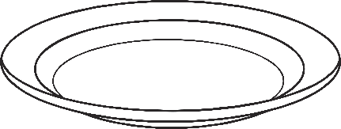


Which food is this alien thinking about?
Try again!
Correct!
Try again!
Practitioner – clap 2 beats for popcorn
Next

Slide 13




Which food is this alien thinking about?
Try again!
Correct!
Practitioner – clap 3 beats for tomatoes
Try again!
Next

Slide 14



Which food is this alien thinking about?
Try again!
Correct!
Practitioner – clap 1 beat for cake
Try again!
Next

Slide 15
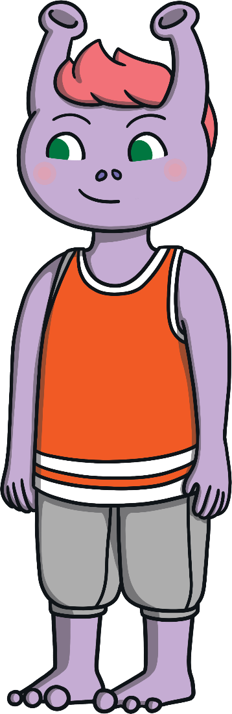



Which food is this alien thinking about?
Practitioner – clap 4 beats for avocado
Try again!
Correct!
Try again!

