Slide 2
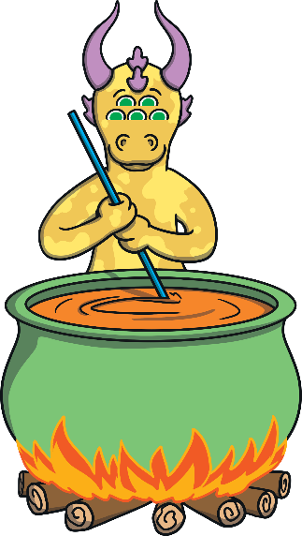
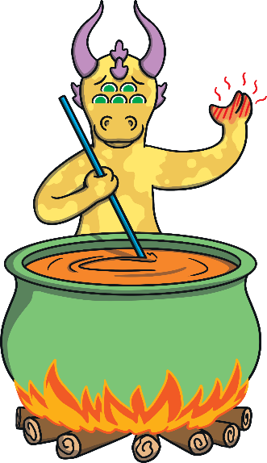


Aliens cook soup in a pot,
be careful it’s very...
Aliens cook soup in a pot,
be careful it’s very hot!
Next

Slide 3
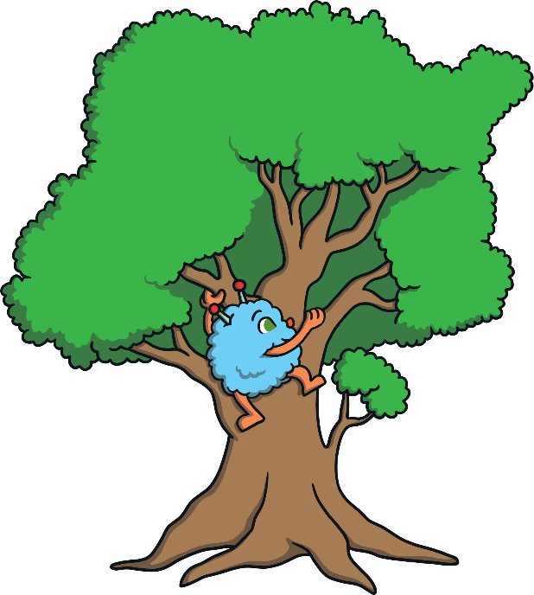
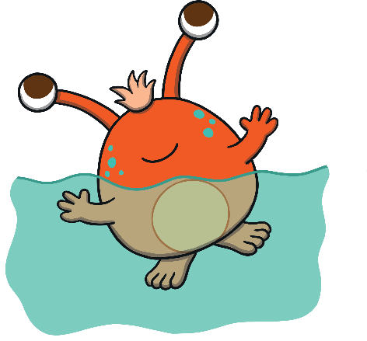
Some aliens like to swim in the sea, some would prefer to climb a…
Some aliens like to swim in the sea, some would prefer to climb a tree.
Next

Slide 4
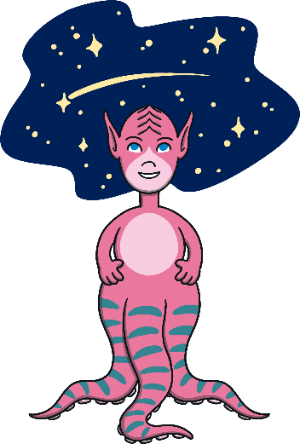
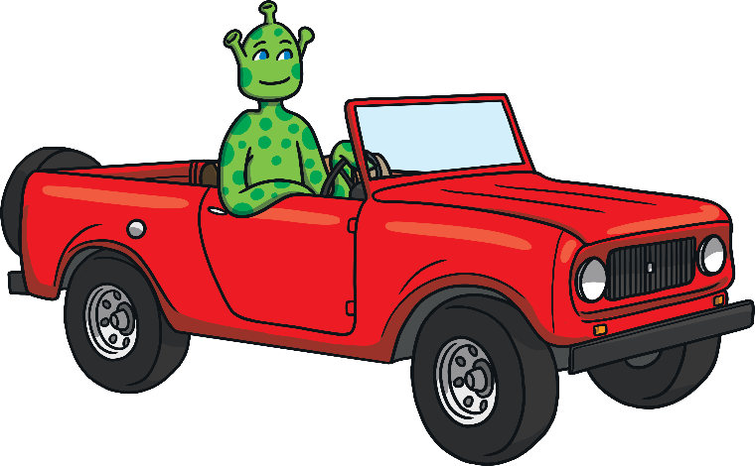
Pink aliens like watching stars, green aliens like driving...
Pink aliens like watching stars, green aliens like driving cars.
Next

Slide 5
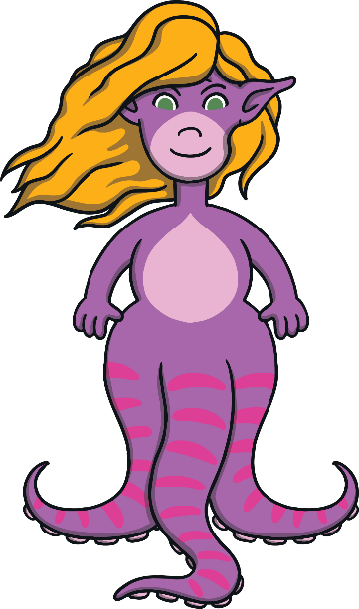
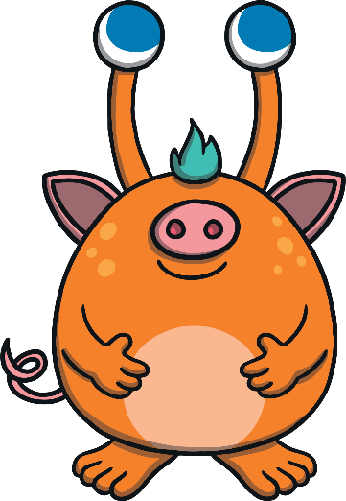
This alien is dressed in a wig, this alien is dressed like a....
This alien is dressed in a wig, this alien is dressed like a pig.
Next

Slide 6
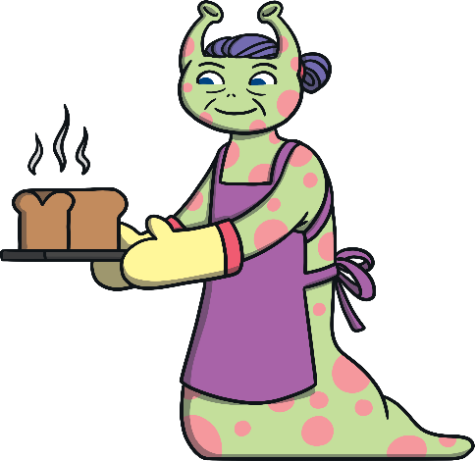
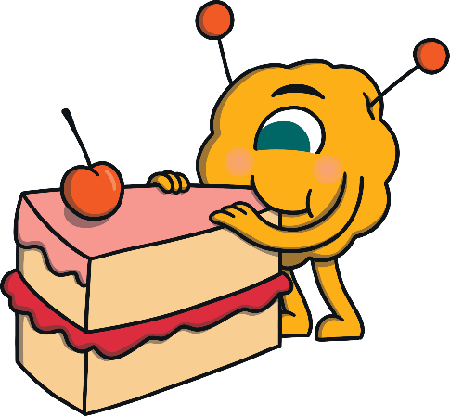
Old aliens like to bake, young aliens like to eat...
Old aliens like to bake, young aliens like to eat cake
Next

Slide 7
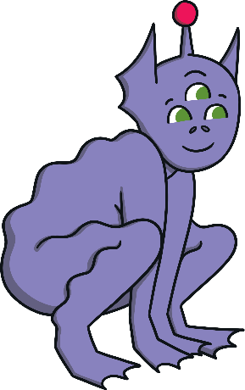
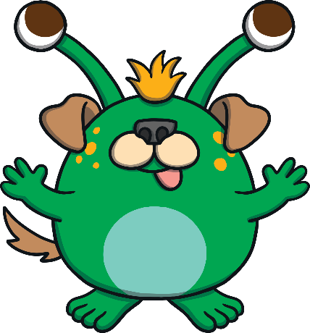
This alien can jump like a frog, this alien pretends he’s a....
This alien can jump like a frog, this alien pretends he’s a dog.
Next

Slide 8
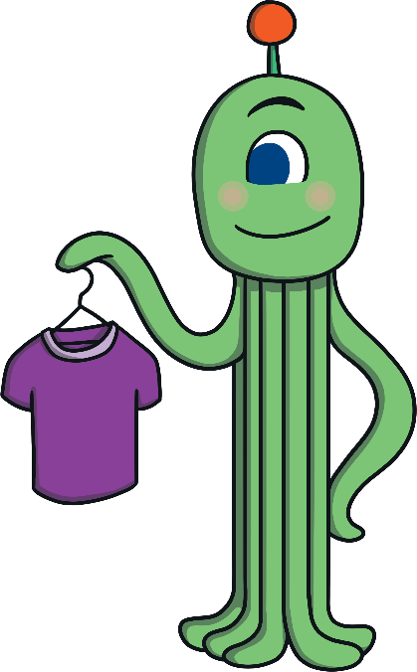
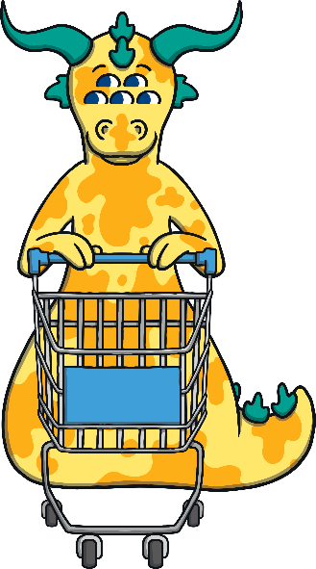
Some aliens go to the shops, some aliens never buy...
Some aliens go to the shops, some aliens never buy tops.
Next

Slide 9
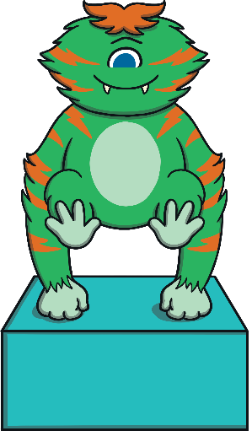
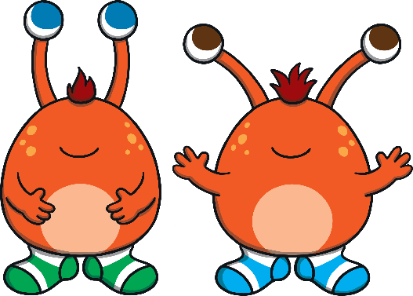
Red aliens like to wear socks, two aliens are holding a...
Red aliens like to wear socks, this alien stands on a box.
Next

Slide 10
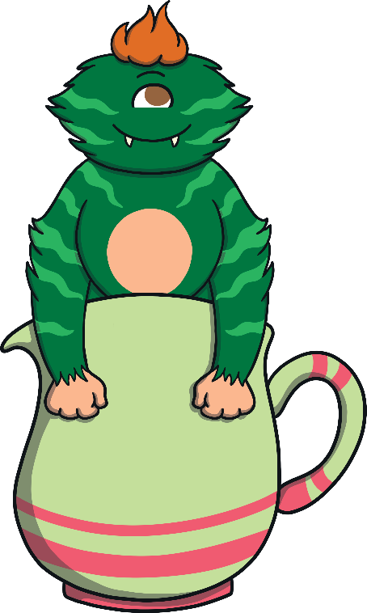
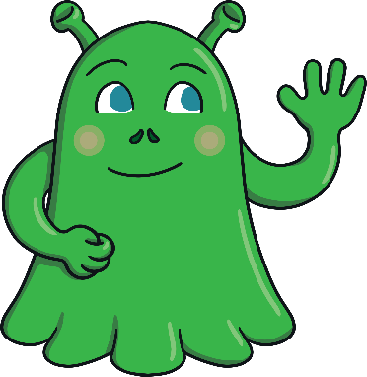
This alien is slimy like a slug, this alien is sat on a jug.
This alien is slimy like a slug, this alien is sat on a...
Next

Slide 11
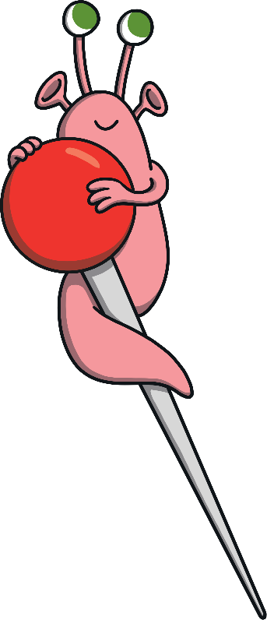
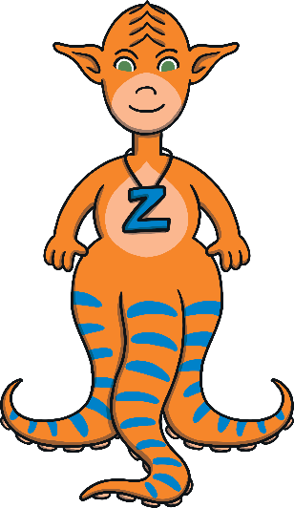
The tall alien is called Zin, the small alien is stood on a...
The tall alien is called Zin, the small alien is stood on a pin.

