Slide 1
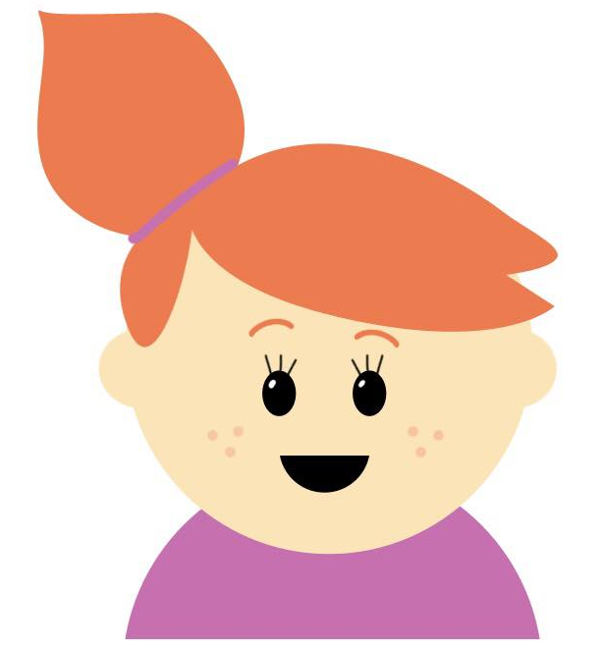

Progression in Mastery
The Alphabet
Are you ready to learn about the alphabet?
©Deepening Understanding LTD 2020

Slide 2
Let’s do this!
Say each of the letters below…
What do you notice about them?
a
c
e
b
d
©Deepening Understanding LTD 2020

Slide 3
Let’s revisit what we should know…
Talk to your partner to answer Millie’s question.
What is the alphabet?
©Deepening Understanding LTD 2020

Slide 4
Let’s learn
There are _______ letters in the alphabet.
Let’s say them together…
a
b
c
d
e
f
g
h
i
j
k
l
m
n
o
p
q
r
s
t
u
v
w
x
y
z
We all say it!
You say it!
I say it!
©Deepening Understanding LTD 2020

Slide 5
Let’s talk
Which letters from the alphabet are missing?
b
w
r
m
a
l
d
s
p
f
e
y
u
x
j
z
h
t
k
g
v
n
c
q
©Deepening Understanding LTD 2020

Slide 6
Let’s talk
Put the letters below in alphabetical order…
s
p
g
b
k
©Deepening Understanding LTD 2020

Slide 7
Let’s talk
Complete the alphabetical sequences below…
q
r
u
c
e
©Deepening Understanding LTD 2020

Slide 8



Let’s talk
What letter do each of these words begin with?
_og
_ree
_oat
©Deepening Understanding LTD 2020

Slide 9
Let’s talk
Put the words in alphabetical order.
dog
tree
boat
©Deepening Understanding LTD 2020

Slide 10
Let’s develop our learning
Name one word which could come before boat in this sequence.
Name one which could come after tree in this sequence!
boat
dog
tree
©Deepening Understanding LTD 2020

Slide 11
Let’s develop our learning
Millie’s name uses 4 letters from the alphabet.
How many letters does your name use?
Which of your classmates uses the most letters in their name?
M i l l i e
©Deepening Understanding LTD 2020

Slide 12
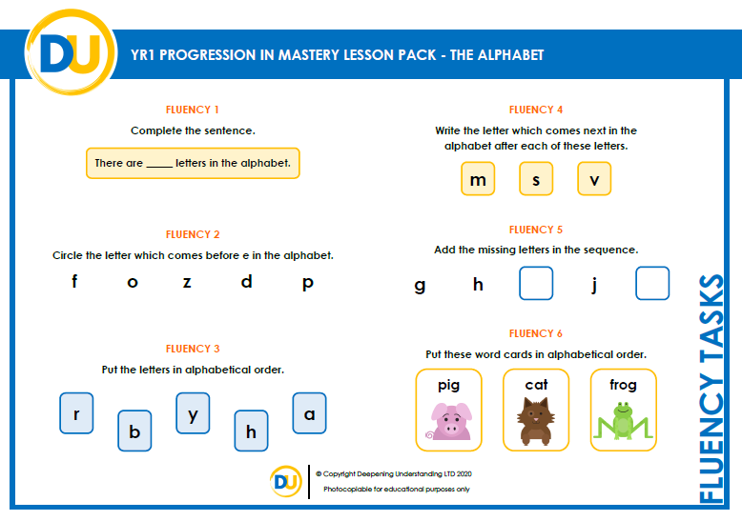
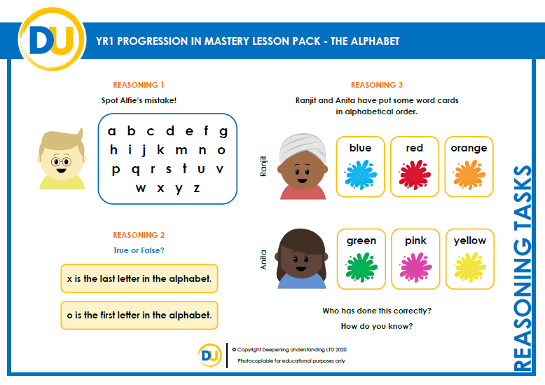
Independent Task
Let’s showcase our learning
©Deepening Understanding LTD 2020

Slide 13





Exit task – Dong Nao Jin
Can you put the words below in alphabetical order?
pan
penguin
paint
penny
pencil
©Deepening Understanding LTD 2020

