Slide 1

EYFS Maths Forum
14.01.20

Slide 2
Mastery and CPA
Deep, long-term understanding
All pupils can achieve
Factual/procedural and conceptual fluency
Embed learning
Notes:
1.) Through resources, multiple representations and applying to problems, children develop a deep, long term understanding.
2.) Spending longer on units help to embed learning with more opportunities to practice and apply.
3.) Encourage children to move from procedural (learning and reciting) to conceptual (knowing and applying to other contexts)
4.) All pupils moving together to avoid gaps and ceilings- elements of choice.

Slide 3
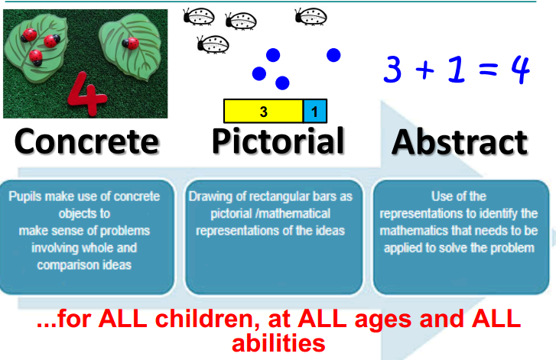
Mastery and CPA

Slide 4
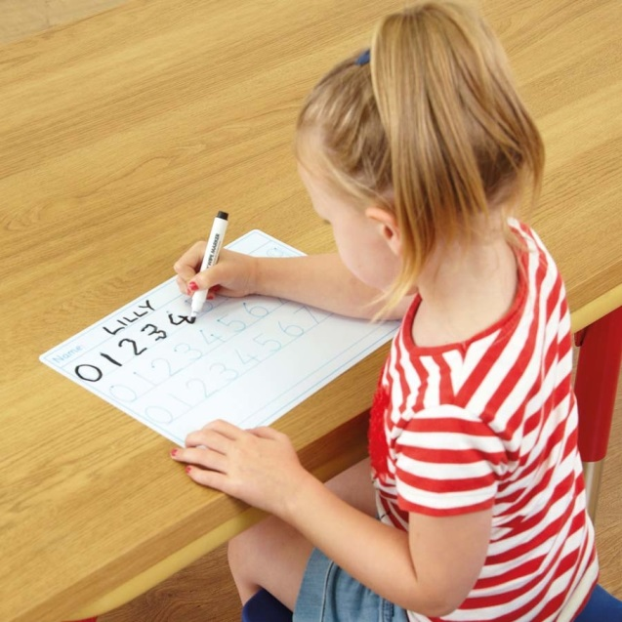
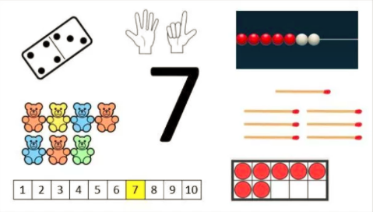
Knowing Number
VS

Slide 5
Knowing Number
Has been done up to 10
Subitizing
Number of the week
Represent concretely/pictorially
Hiding an amount and knowing what is missing
Vocabulary
Number stories

Slide 6
Subitizing
The ability to instantly ‘see’ a small set of dots without counting
Supports fluency and recognition of number
Children aged around 5 should be able to subitize up to 10 by splitting the bigger numbers
Dice

Slide 9
Vocabulary
Don’t use symbols for addition/subtraction but do it practically using ___ and ___ is ____
One more than, one less than
How many altogether?
How many are missing?

Slide 10

How do you show challenge if you are working with smaller numbers and spending longer on them?

Slide 11
Challenge
Not bigger numbers
Variety of contexts
Finding all possibilities/range of resources
Visualisation

Slide 12
Helping at home
Practical:
Doing addition and subtraction but not with symbols
Counting objects
Using context- e.g. shopping items, toys, number games (problem solving)
Doubling/halving- exceeding
Number stories- make up their own
Look at website

Slide 13
Questions!

