Slide 1

Addition, Subtraction, Multiplication and Division
Spurcroft Primary School.

Slide 2
The Mastery Approach
All pupils can achieve
Deep, long-term understanding
Procedural and conceptual fluency
Embed learning

Slide 3
Key Skills
Knowing numbers well from the outset and be able to use them fluently
Being able to manipulate and represent numbers in different ways- using resources and pictorially
Times tables are vitally important- expectations are a lot higher than they used to be!
Importance in regular counting to embed understanding

Slide 4
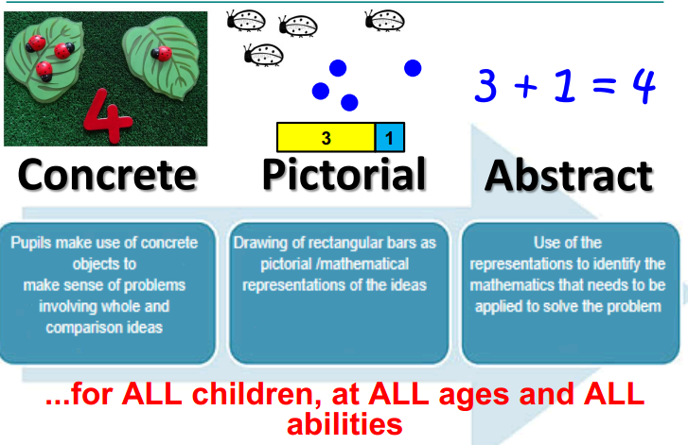
CPA
Notes:
Children who ‘don’t get maths’ have sometimes progressed through too quickly (procedural knowledge) Ensures that children have a deep understanding of numbers/concepts before they move on to the ‘abstract’- just using numbers to represent. Also means children have a variety of strategies to support e.g. a place value chart to identify values.

Slide 5
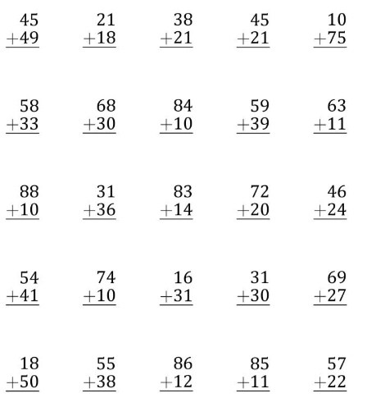


Formal Methods- Procedural vs Conceptual

Slide 6




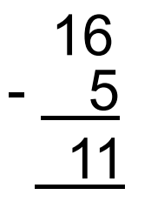
Efficient Methods

Slide 7
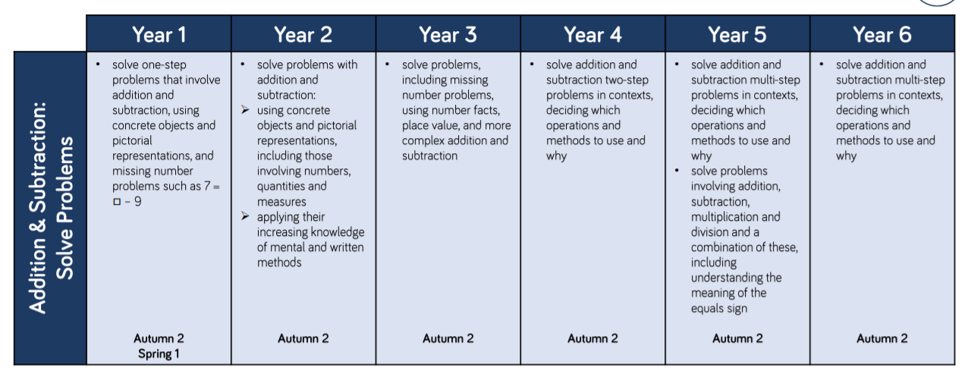

Slide 8
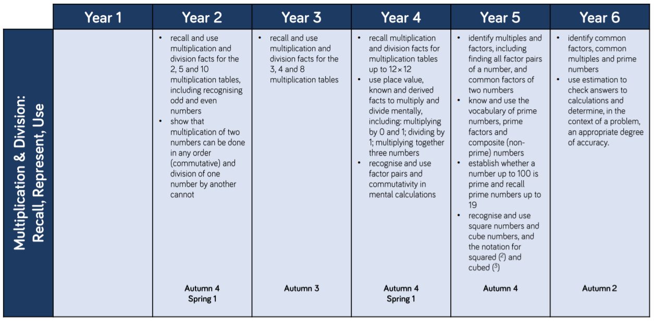
Multiplication Tables!

Slide 9

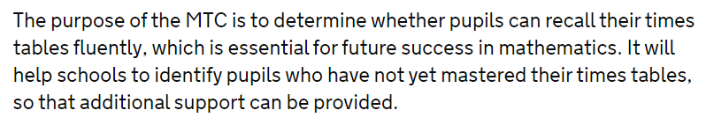
Year 4 Statutory Multiplication Check
Answer 25 times tables questions on a laptop
They are given six seconds per question
Three seconds rest between each question

Slide 10
What you will see!
Modelling of methods for all four operations in each year group.
A range of problem solving style questions that apply to each year group.
How the CPA approach supports children’s learning.
Any resources that are used.

Slide 11
Where to go.
Year 1 and 2 in Holly Class
Year 3 in Pine class
Year 4 in Mulberry class
Year 5 in Juniper Class
Year 6 in Maple Class

